Slide 1
REMOTE PROCEDURE CALLS

Slide 2
Overview
The RPC Model
Transparency
Implementation
Stub Generation
RPC Messages
Marshaling
Server Management
Call Semantics

Slide 3
RPC
The RPC is an accepted IPC mechanism in distributed systems.
A remote procedure call is an interprocess communication technique that is used for client-server based applications.
It is also known as a subroutine call or a function call.

Slide 4
Features of RPC
Simple call syntax.
Familiar semantics - similar to local procedure calls
A well-defined interface.
- Supports compile-time type checking and automated interface generation.
Its ease of use – Simple semantics
Its generality
Its efficiency.
Facilitate to communicate between all processes

Slide 5
RPC MODEL
The caller places arguments to the procedure in some well-specified location.
Control is then transferred to the sequence of instructions that constitutes the body of the procedure.
The procedure body is executed in a newly created execution environment
After the execution is over, control returns to the calling point, With result.

Slide 6


client
server
Call Procedure and Wait for Reply
Req
Receive the req along with RPC parameter and Start the Procedure Execution
Blocked
Send Reply And Wait for Next Req
Reply
Resume Execution
RPC Model
Notes:
‹#›

Slide 7
RPC
Transparency of RPC
Local procedures and remote procedures are indistinguishable to programmers.
TRANSPARENCY
SYNTATIC
SEMANTIC

Slide 8
RPC
The calling process is suspended until the called procedure returns.
The caller can pass arguments to the called procedure (Remote procedure).
The called procedure (remote procedure) can return results to the caller.

Slide 9
Differences between remote procedure calls and local procedure calls
SL NO | LOCAL PROCEDURE CALLS | REMOTE PROCEDURE CALLS
1 | same | Address space is disjoint from the calling program
2 | Have access | called (remote) procedure cannot have access to any variables or data values in the calling program's environment.
3 |  | it is meaningless to pass argument values containing pointer Structures
4 |  | More vulnerable to failures
5 |  | consume much more time (100-1000 times more) than local procedure calls due to communication n/w in RPC

Slide 10
IMPLEMENTING RPC MECHANISM
To achieve semantic transparency, implementation of RPC is based on the concepts of stubs, which provide a local procedure call abstraction
Five elements of program with RPC
The client
The client stub
The RPCRuntime
The server stub
The server

Slide 11
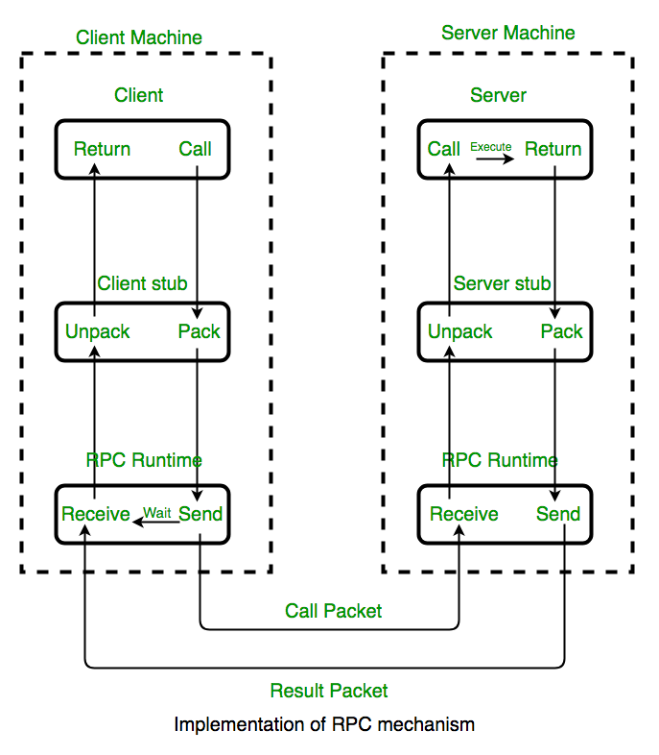

Slide 12
IMPLEMENTING RPC MECHANISM
Client
A user process that initiates a remote procedure call.
Makes a normal local call that invokes a procedure in the client stub.
Client Stub
-A stub is a piece of code that converts parameters during a remote procedure call (RPC)
- Responsible for conversion (marshalling) of parameters and de conversion of results .
packs a procedure and the arguments into a message and ask the local RPCRuntime to send it to the server stub.
On receipt of the result of procedure execution, it unpacks the result and passes it to the client.

Slide 13
IMPLEMENTING RPC MECHANISM
RPC Runtime
Handles transmission of messages between client and server.
Responsible for retransmissions, acknowledgments, packet routing, and encryption.
on the client machine receives the call request message from the client stub. Receives the result of procedure execution
on the server machine receives the message containing the result of procedure from the server stub and receives the call request.

Slide 14
IMPLEMENTING RPC MECHANISM
Server Stub
On receipt of the call request message from the local RPCRuntime, the server stub unpacks it and makes a perfectly normal call to invoke the appropriate procedure in the server.
On receipt of the result of procedure execution from the server, the server stub packs the result into a message and then asks the local RPCRuntime to send it to the client stub.

Slide 15
IMPLEMENTING RPC MECHANISM
Server
On receiving a call request from the server stub,
Executes the appropriate procedure and
Returns the result of procedure execution to the server stub

Slide 16
IMPLEMENTING RPC MECHANISM
STUB GENERATION
Manually.
RPC implement or provides a set of translation functions
User can construct his or her own stubs.
Simple to implement and can handle very complex parameter types.
Automatically.
Commonly used method for stub generation.
Uses Interface Definition Language (IDL) for defining the interface between a client and a server.

Slide 17
CALL
RPC MESSAGES
RPC
Messages
REPLY

Slide 18
RPC MESSAGES
Call Messages that are sent by the client to the server for requesting execution of a particular remote procedure
Reply Messages that are sent by the server to the client for returning the result of Remote Procedure Execution

Slide 19
RPC MESSAGES
The FIVE basic components necessary in a call message are as follows:
The identification information of the remote procedure to be executed
The arguments necessary for the execution of the procedure
A message identification field that consists of a
sequence number identifying lost/duplicate messages
For properly matching reply messages to outstanding call messages
A message type field that is used to distinguish call messages from reply messages.
A client identification field for executing the
concerned procedure - To allow the server to identify the client to send the reply message and to authenticate the client

Slide 20
RPC MESSAGES
CALL MESSAGE
MESSGE IDENTIFIER | MESSAGE TYPE | CLIENT IDENTIFIER | REMOT PROCEDURE IDENTIFIER |  |  | Arguments
 |  |  | PROGRAM NUMBER | VERSION NUMBER | PROCEDURE NUMBER

Slide 21
RPC MESSAGES
REPLY MESSAGES
1. Server finds that the call message is not intelligible to it. Happens when a call message violates the RPC protocol. The server rejects it.
Server scans the clients identification field and detects client is not authorized to use the service. The server will return an unsuccessful reply
The server finds that the remote program, version, or procedure number in the remote procedure identifier of the call message not available with it. Will return an unsuccessful reply
The remote procedure is not able to decode the supplied arguments.
An exception condition (such as division by zero) occurs while executing the specified remote procedure.

Slide 22
RPC MESSAGES
SUCCESSFUL
Meaage Identifier | Message Type | Reply Status (Successful) | Result
UNSUCCESFUL REPLY
Message Identifer | Message Type | Reply Status (UnSuccessf ul) | Reason for failure

Slide 23


Marshalling Arguments
Implementation of remote procedure calls
Transfer of arguments
CLIENT
SERVER
Results

Slide 24
Marshalling Arguments
Transfer of message data requires encoding and decoding of the message data.
For RPCs this operation is known as Marshaling and involves the following Actions:
Taking the arguments of a client process or the
result of a server
Encoding the message data of step 1 above on the sender's computer.This encoding process involves the conversion of program objects into a stream form that is suitable for transmission and Placing them into a message buffer.
Decoding of the message data on the receiver's
Computer.The reconstruction of program objects from the message data that was received in stream form.

Slide 25
Marshalling Arguments
Marshalling may be
Provided as a part of the RPC software- Marshalling procedures for scalar data types and compound types build from the scalar ones
Those that are defined by the users of the RPC system- Marshalling procedures for user defined data types and dat types that include pointers
A good RPC system
generate in-line marshaling code for every remote call
it is difficult to achieve this goal because of the large amounts of code

